Slide 1
Analyzing and Predicting Traffic Speeds for New York City
AIT 614: Big Data Essentials
George Mason University
4/27/2022

Slide 2
Team
Cross Zeigler
Ewin Hong
Neethu Battula
Sagar D. Goswami
Suchada Hapikul
In guidance of Dr. Liao
Notes:
May want to follow the template of the proposal and final deliverable/paper
Talk about (in addition to what’s on the project guide): The problem, what we hope to solve
Introduction: Cross
Goals: Fon
Project Timeline: Fon
Function Requirements: Ewin
Selected Datasets: Sagar
The System: Cross
Experimental Results & Analysis: Fon
K-Means Clustering: Ewin
Time Series Pt. 1: Neethu (slides 14-21)
Time Series Pt. 2: Sagar (slides 22-23)
Decision Tree (dropped): Neethu
MARS (optional): Sagar
Conclusions: Cross
Lessons Learned: Fon
Future Considerations: Ewin

Slide 3
Introduction
New York City (NYC) is notorious for bad traffic
Study traffic within NYC to chart out congestion/traffic speed
Create models to predict traffic speeds within NYC
Hourly, daily, weekly, yearly
Provide recommendations to improve infrastructure
Stakeholders:
Urban transportation industry and transportation agencies
Emergency Services
NYC residents
Notes:
Project Guide: In particular, briefly describe the difference of your solution(s) from others.

Slide 4
Goals
Create machine learning models based on previous NYC traffic data
Sourced from New York City Department of Transportation
Determine how traffic works within NYC
Provide insight into traffic system for improved transportation
Times & areas with greatest congestion
Improve commuting schedules in the short-term
Overhaul transportation infrastructure for the long term
Notes:
Fon:
Project Guide: In particular, briefly describe the difference of your solution(s) from others

Slide 5
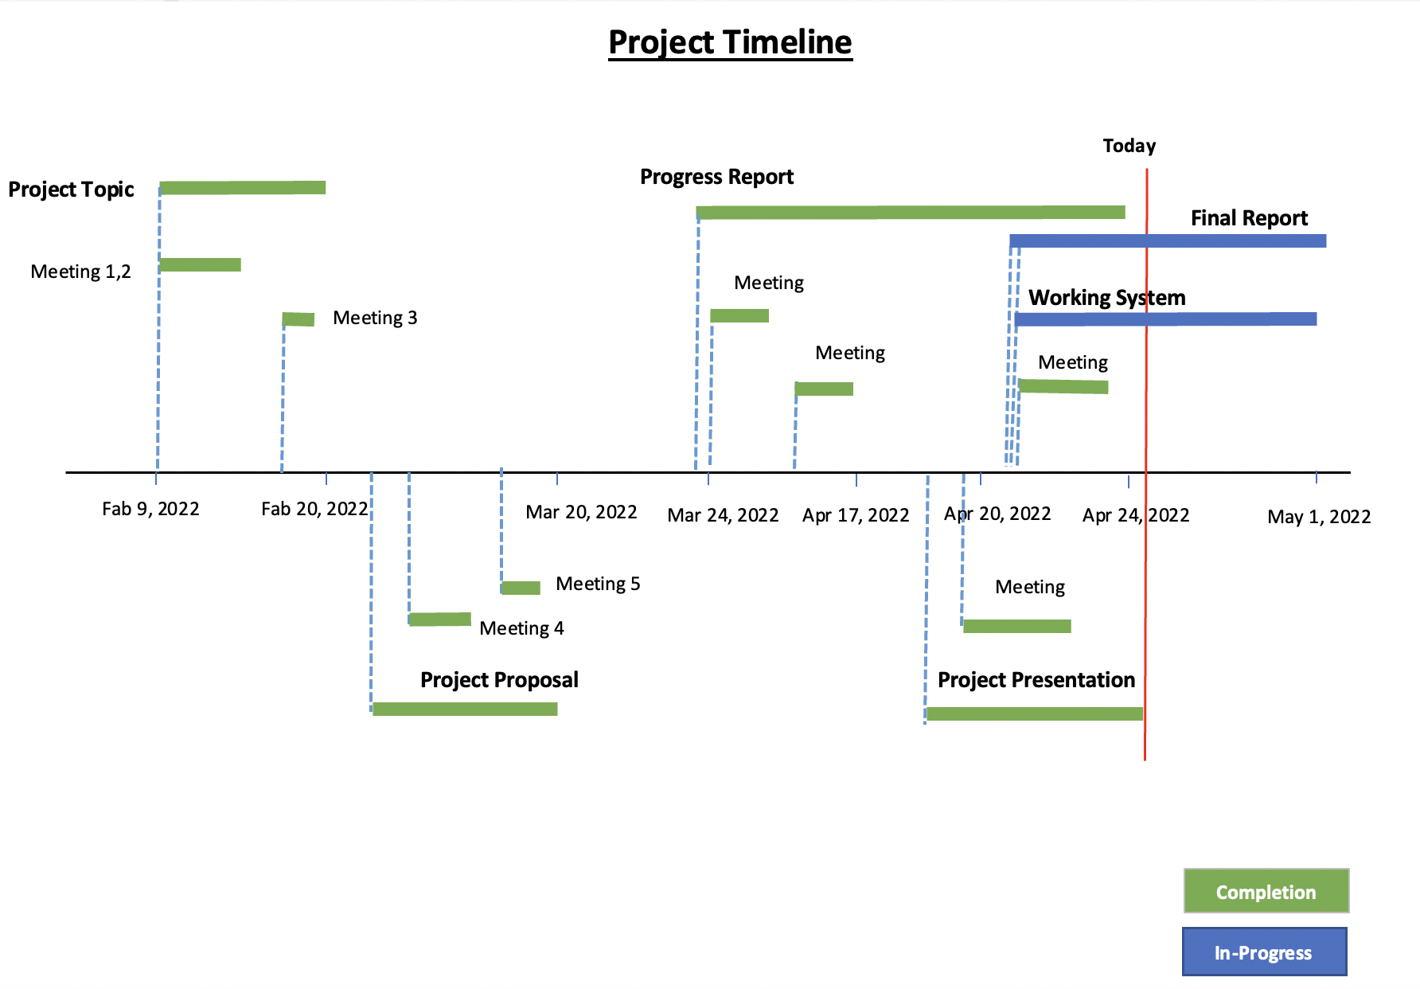
Project Timeline
Notes:
Fon

Slide 6
Functional Requirements
Python / R
Extracting, processing, cleaning, exporting data
Pandas, Prophet, etc.
Initial storage and exporting for data
earth library (MARS) - R
Databricks / Spark
Data Exploration using Spark SQL
Spark MLLib - k-means, PCA
Databricks DBFS
GitHub (Version Control), Microsoft Teams (Communication), Google Drive (Shared File Storage)
Notes:
Our functional requirements were largely based on Python / R and Databricks or Spark.
Preliminary exploration was done in python but due to computational limitations Spark/Databricks provided a better data exploration process using Spark SQL.
Later on, we used the Facebook Prophet python library to perform the time series analysis.
In addition to Facebook Prophet, we used Spark MLLib kmeans and principal component analysis
We used tableau as a map visualization for some geospatial analysis
Additional, the team used various collaboration tools for code sharing and file sharing (github/onedrive/google drive) and teams communication

Slide 7
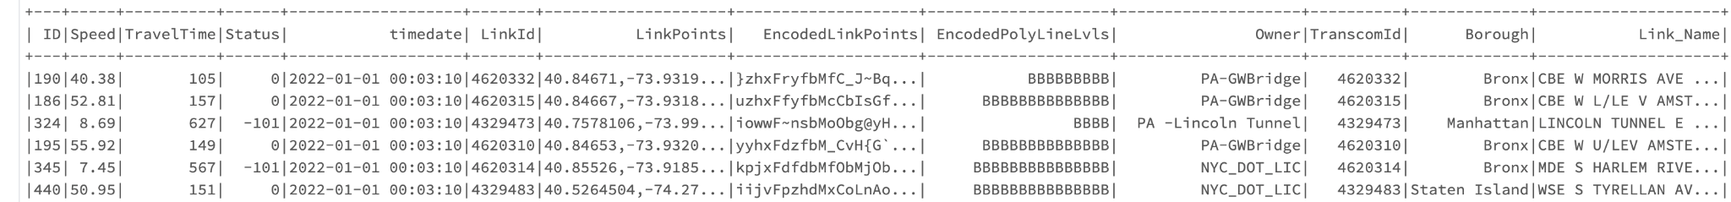
Selected Dataset
DOT Traffic Speeds NBE
Collecting data since April 17th, 2017
Continuously updated daily
60.2 Million records as of April 21st, 2022
25 GB in raw csv format, (compressed to 450 MB parquet file)
13 features within the dataset
Notes:
Project Guide: Briefly describe the dataset and pre-processing
Dataset:
NYC DoT Traffic Speeds Data (Open Data Portal)
Collecting data since April, 2017, updated at regular intervals
Total 14 columns (7 major features)
Original SIze is 25 GB, we convert it into a parquet file to import it in the Databricks, that converted 25 GB of file to just 450 MB.
Uploaded it to dbfs - Databricks File System
The dataset had significant gaps of time in 2017 where no sensor reading was provided.
Linkpoints with less than 45000 records were excluded.
The link points from the original source had a maximum length of 255
We noticed the linkpoints for 1 direction was identical for the opposite direction

Slide 8
The System
Databricks
Collaborative platform to run models on
Apache Spark
Used within collaborative Databricks to make predictive models
Spark MLlib
Machine learning library with Apache Spark used for:
Clustering
Regression
Notes:
Project Guide: Architecture/framework, Data analytics approaches, SW/HW development platforms
On Google Cloud
Databricks 10.4 LTS ML
Apache Spark 3.2.1
1 master and 2 workers - varied configuration 8 cores and 52 gb of ram

Slide 9
Experimental Results & Analysis
Techniques we started with:
Started with clustering and Linear Regression
Linear Regression too simple for project complexity, tried MARS Analysis
Other Attempted Techniques:
Decision Trees, Association Rule Mining and Time-Series
Final Outcome:
Clustering and Time-Series performed exceptionally well for the data we have
Not proper libraries available for Decision Trees and MARS
MARS was not scalable to the data, took too much of time to process
Notes:
Fon
What we started with:
Started with clustering and Linear Regression.
Linear Regression wasn't enough to address the complexity of the project, tried MARS Analysis.
Also tried other methods as well (Decision Trees, Association Rule Mining and Time-Series)
Final Outcome:
Clustering and Time-Series performed exceptionally well for the data we have.
Not proper libraries available for Decision Trees and MARS.
MARS was not scalable to our data, took too much of time to process.

Slide 10
K-Means Clustering / PCA (NYC: DoT Traffic Speed Dataset)

Slide 11
K-Means Clustering / PCA
Evaluated traffic dataset using k-means clustering and Principal Component Analysis (PCA)
Of 139 linkpoints, each linkpoint provides 24 features for average speed by hour and standardized using Spark StandardScaler class
Performed a clustering evaluation to best determine # of clusters to target within k-means.
After evaluating cluster, 3 clusters were determined and perform PCA on standardized features.
Cluster breakdown:
Cluster 1 - 14
Cluster 0 - 75
Cluster 2 - 47
Notes:
K-means clustering and principal component analysis was used to help categorize the data from the traffic dataset,
With 139 distinct traffic sensor, we calculated an average speed by the hour per link point so a total of 24 features were feed into k means and PCA
With Spark MLLib, we used clustering evaluation from 2 to 10 cluster to best determine # of clusters to target within k-means.
After the evaluation, the results provide 3 clusters as the optimal # of clusters and perform PCA on standardized features.
Cluster 1 - 14
Cluster 0 - 75
Cluster 2 - 47
On the next slide, we will take a look at cluster 1 as the smallest cluster and determined as the slowest cluster on a map and box and whisker chart.

Slide 12
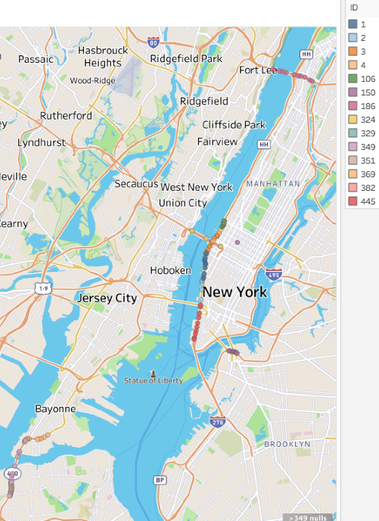
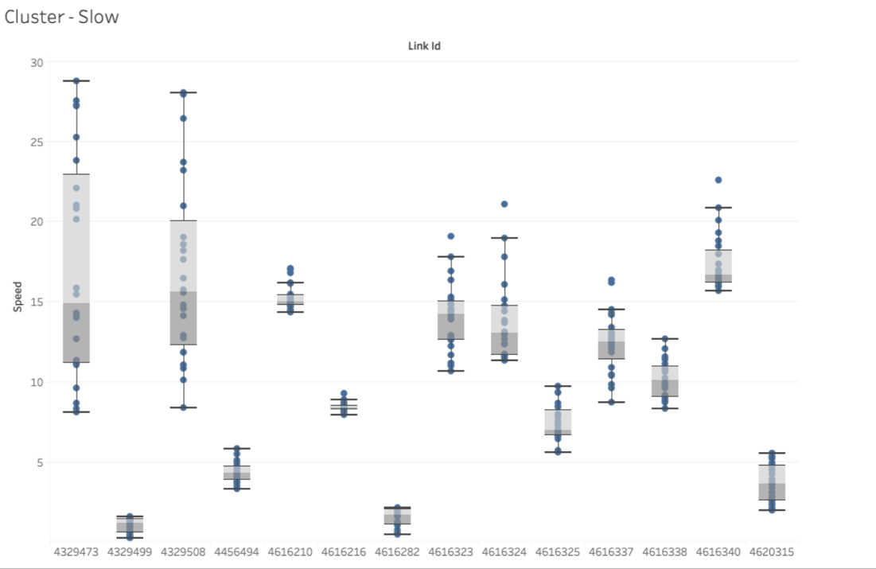
K-Means Clustering / PCA Results
Notes:
The image on the left is a map of the link points and their paths. From this visualization, one could annotate that cluster 1 are close to crossing a bridge or driving through Manhattan borough.
After correlating the link ids back to the original features, the visualization on the right indicates that these 14 link points had consistently lower average than the other link points.
4329473 - 324 - Bridge above Hoboken - yellow
4329499 - 349 - Lower left hand corner of map - pink
4329508 - 329 - above Left of New York - light blue
4456494 - 445 - Lower Manhattan - red
4616210 - 351 - Lower left hand corner of map - tan
4616216 - 382 - Lower left hand corner of map, below 400 - light pink
4616282 - 369 - lower left hand corner of map, below bayonne - light orange
4616323 - 106 - top of line in manhattan - green
4616324 - 3 - bridge above ny - orange
4616325 - 2 - left of ny - l
4616337 - 1 - left above ny - dark blue
4616338 - 4 - n above lincoln bridge - light orange
4616340 - 150 - south east brooklyn bridge - purple
4620315 - 186 - north bridge - purple

Slide 13
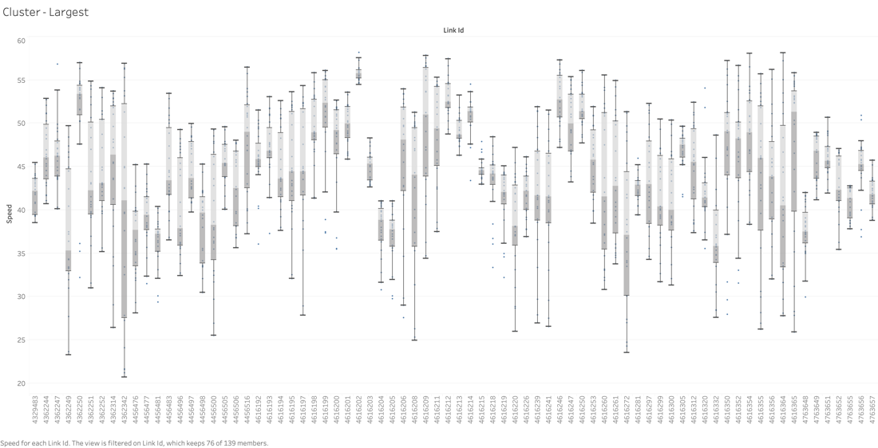
Largest cluster

Slide 14
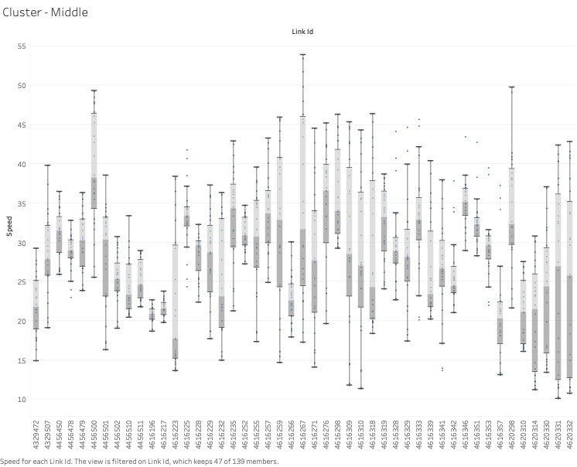
Middle Cluster

Slide 15
Time-Series Analysis (NYC: DoT Traffic Speed Dataset)

Slide 16
Time Series Analysis
About FBProphet
Model Assumptions and Constraints
Time-Series Analysis
Data Exploration
Model Parameters
Projections
Notes:
How Sagar worked with Time Series Analysis
How the predictions were made
How when using this model we can predict what the traffic will be like in the future

Slide 17
About FBProphet
Developed by Meta (previously Facebook, hence the name FB-Prophet)
Based on sklearn API
Takes 2 sets of inputs:
ds (DateTime/TimeStamp) column
y numeric Data column (only support 1 numeric value)
Analyzes the deltas/variations of y w.r.t. ds.
Breaks dows variations into components based on model parameters:
Overall Trend
Yearly Patterns
Weekly Patterns
Daily Patterns

Slide 18
Model Assumptions and Constraints
Total 139 Link Points (source of traffic speed data)
Time-Series data averaged for all the Link Points.
Some might be slower (inner streets, intersections)
Some might be faster (major highways, freeways)
The model represents the overall average speed for entire New York City at any given time of day, day of week, day of year, and years from 2018-2021.
Lower average speeds are inferred as higher possibility for congestions. In reality, vehicle density has to be considered as well. Unfortunately, no data available for that.

Slide 19
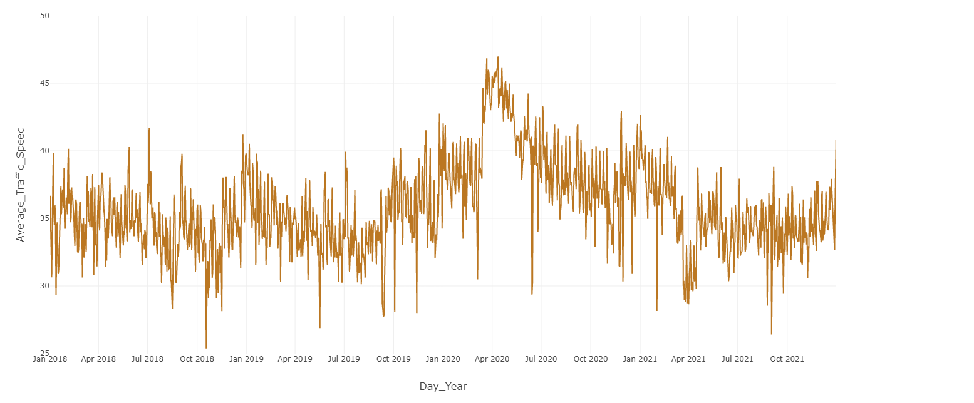
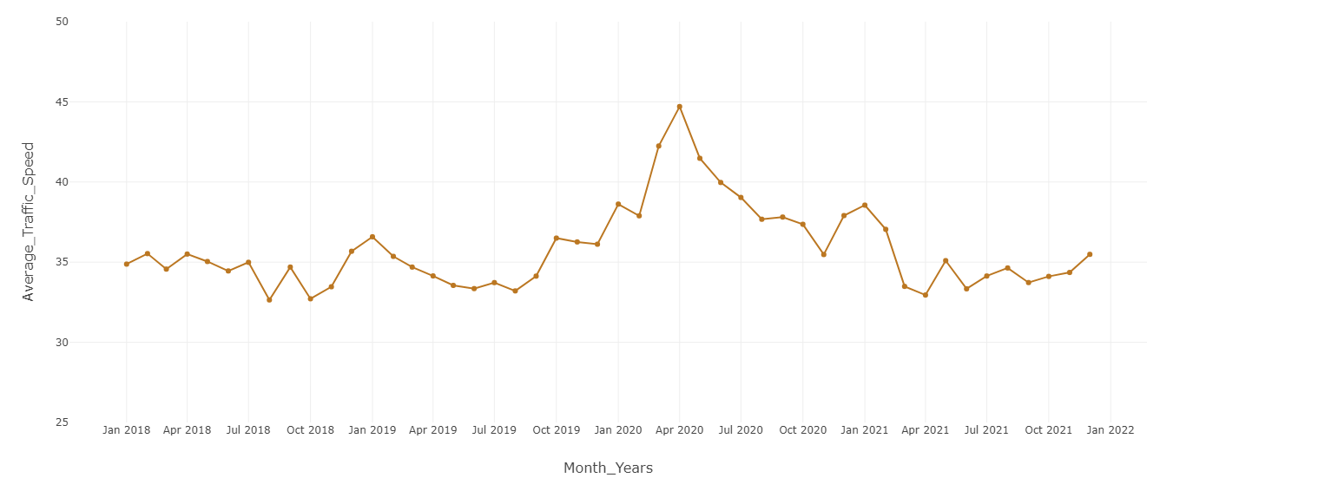
Time-Series Exploration: Overall Trend

Slide 20
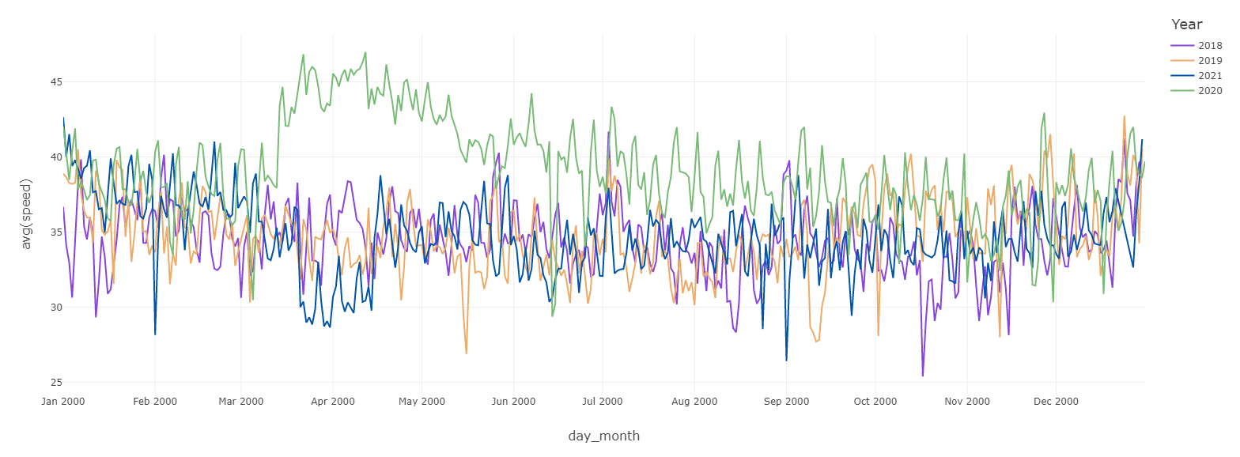
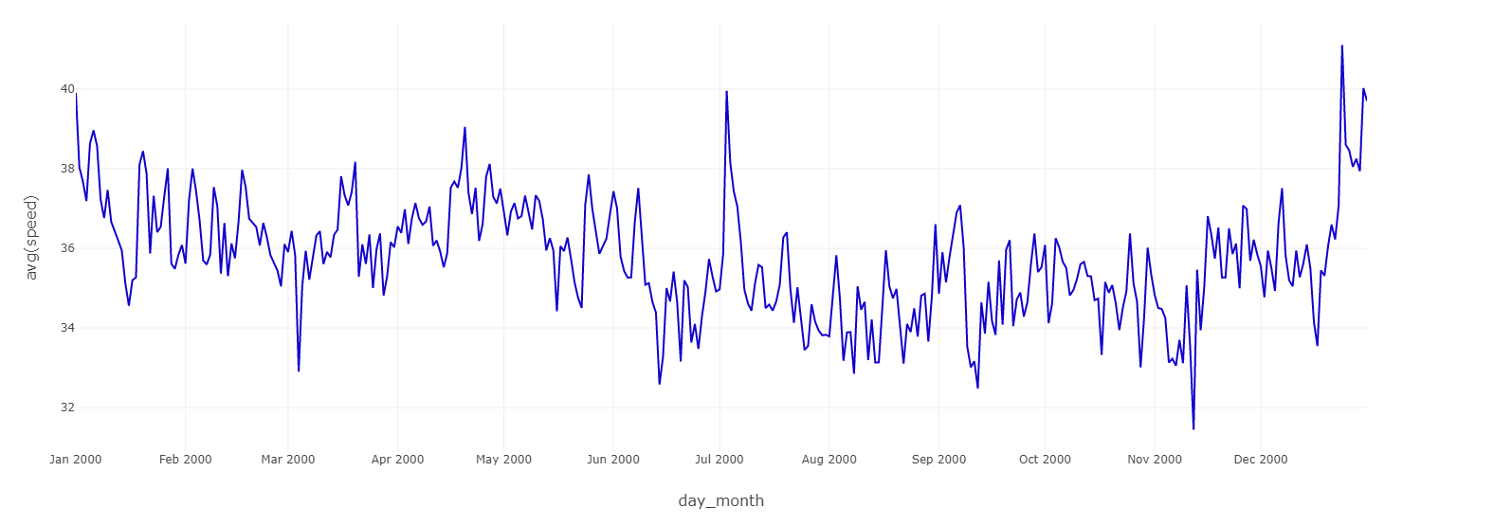
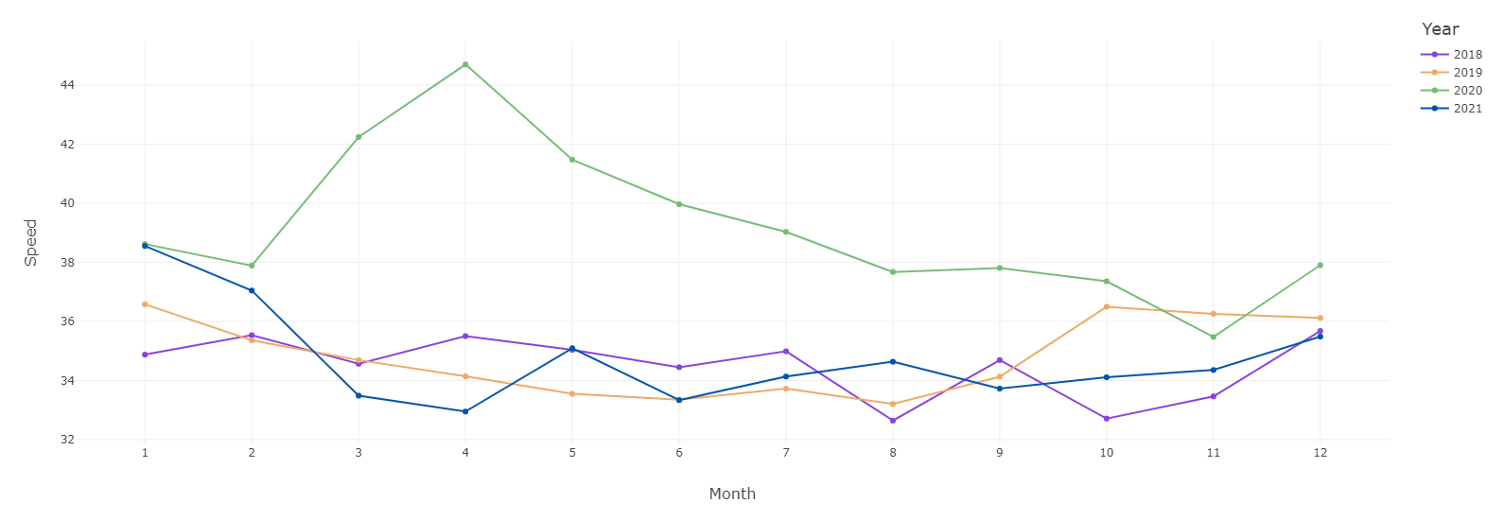
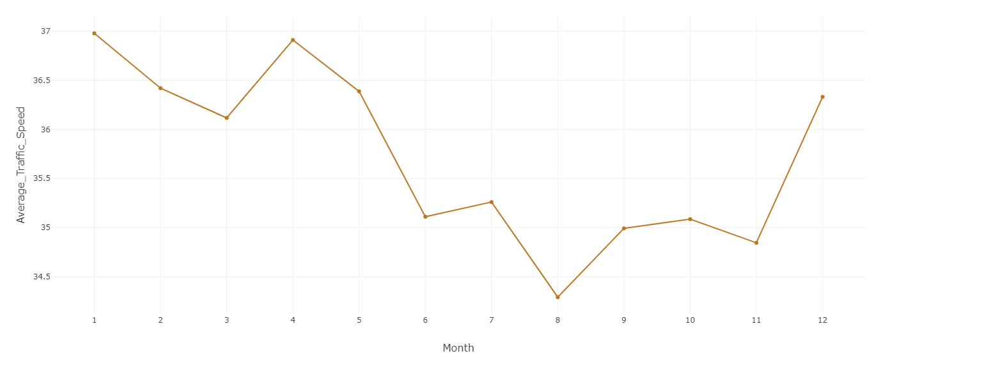
Time-Series Exploration: Yearly Pattern

Slide 21
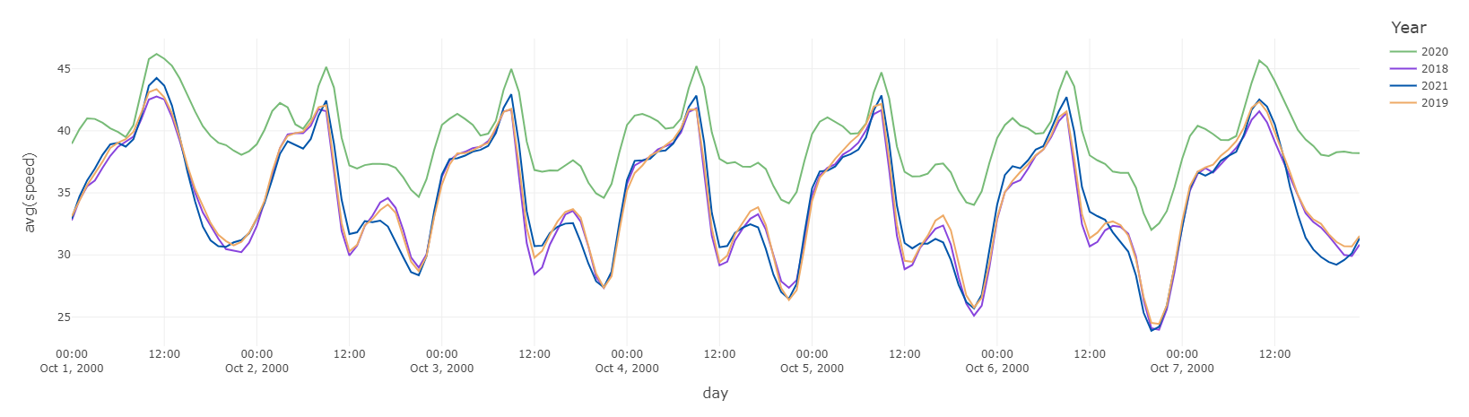
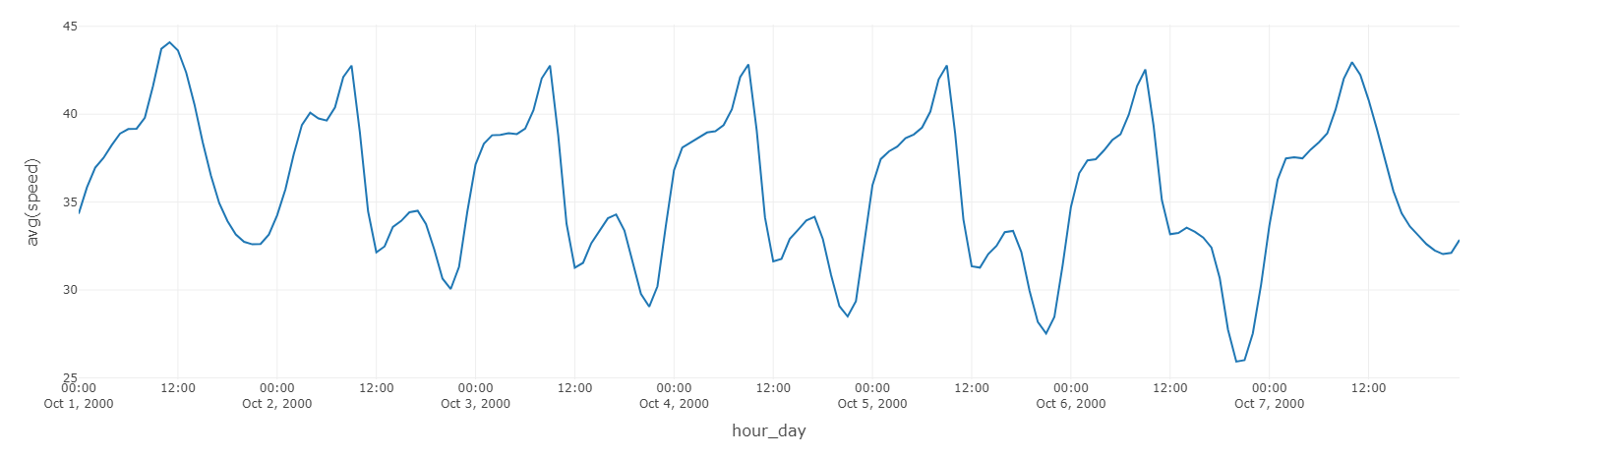
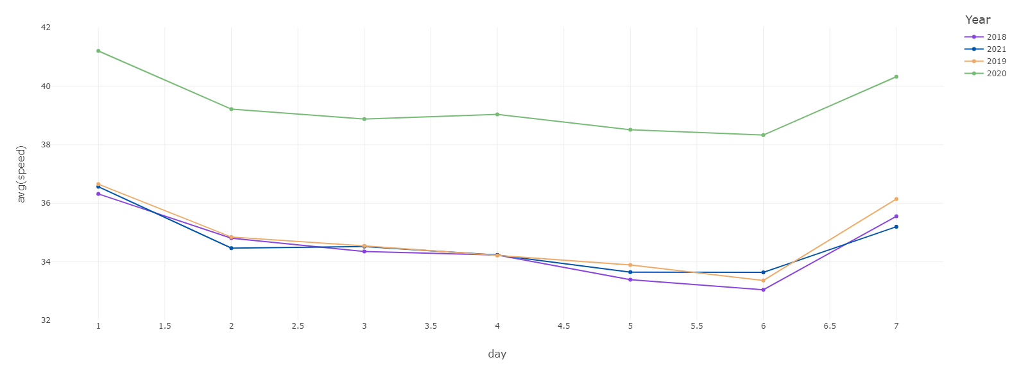
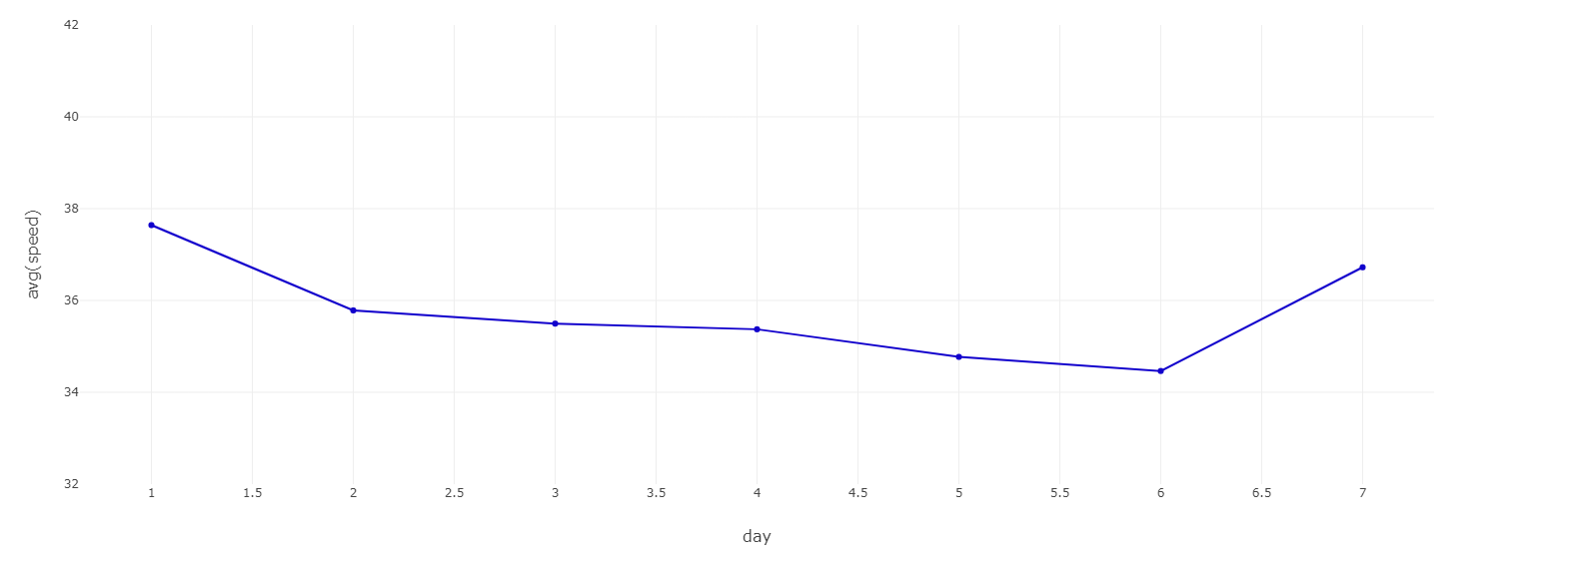
Time-Series Exploration: Weekly Pattern

Slide 22
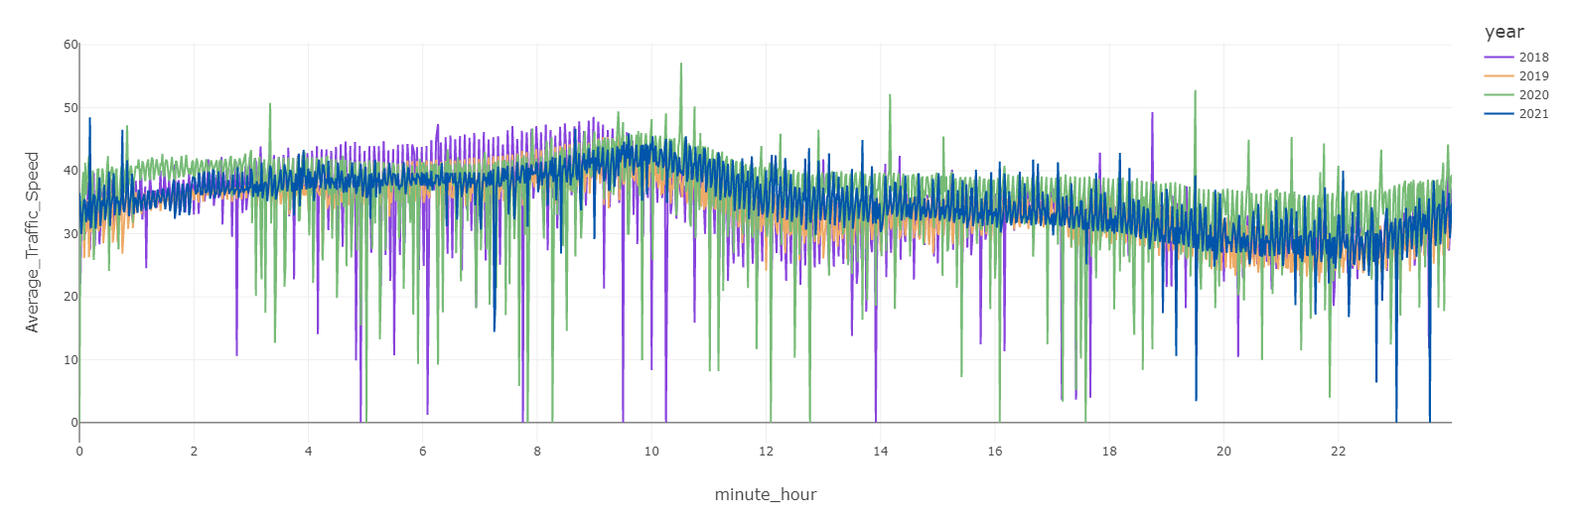
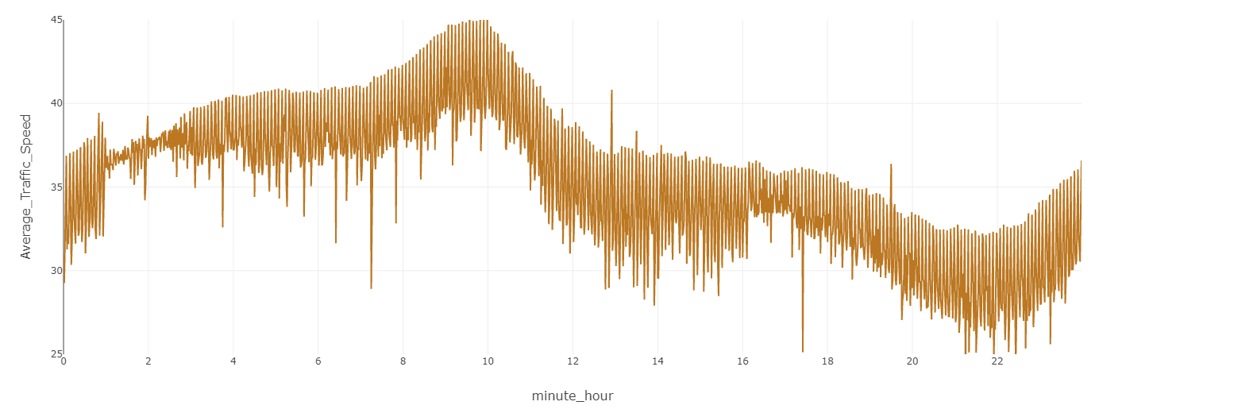
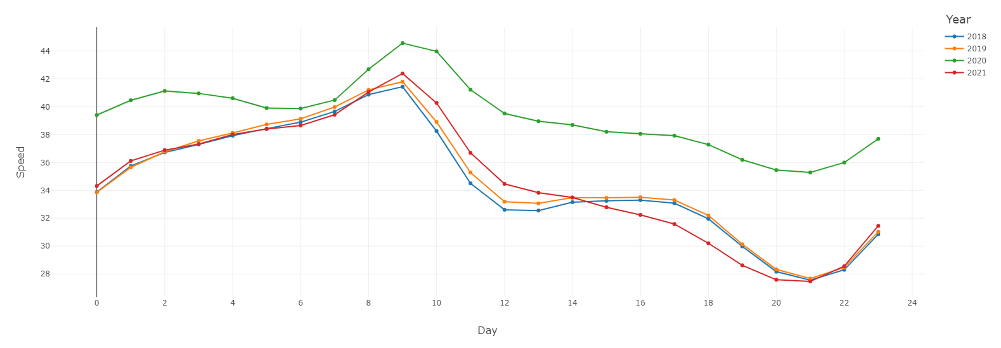
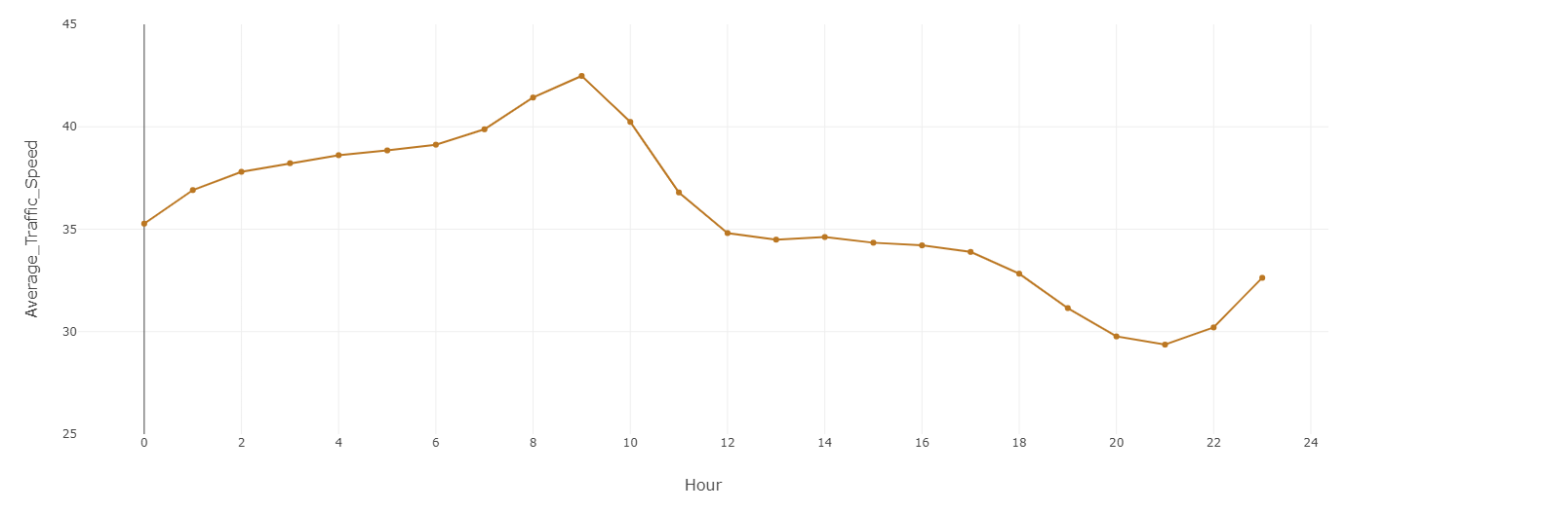
Time-Series Exploration: Daily Pattern

Slide 23
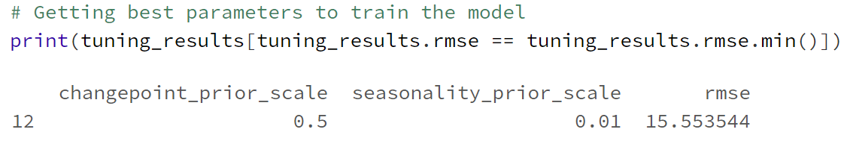
Time-Series Model Parameters
ts_model = Prophet(
changepoint_prior_scale=0.5, # determines flexibility of trend
seasonality_prior_scale=0.01, # determines flexibility of seasonality
interval_width=0.9, # defines Confidence Interval for predictions
daily_seasonality=True,
weekly_seasonality=True,
yearly_seasonality=False
)
Notes:
100K Sample Data
Testing Parameteres
90 Day Cross Validation
Extracting Performance Metrics (RMSE)
Used the same parameters for full model.

Slide 24
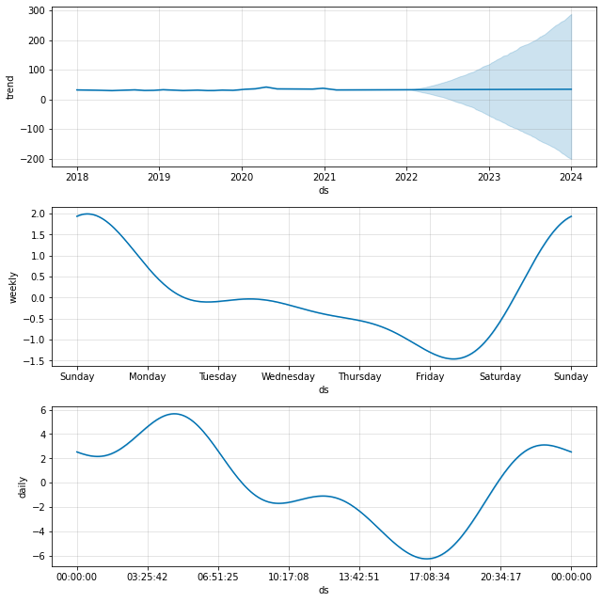
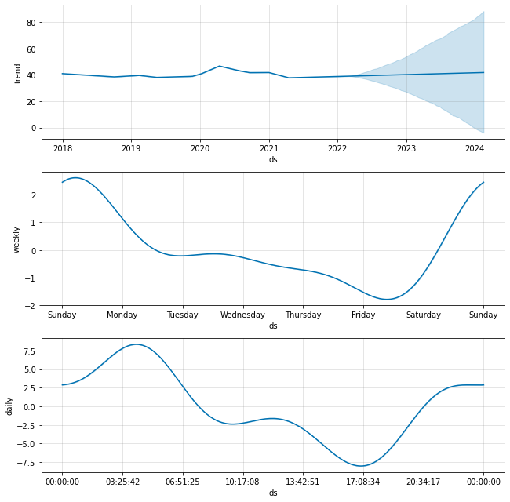
Time-Series Model
Notes:
The trend looks fairly linear, except for a small bump for Year-2020, more on it later.
The variations for daily and weekly pattern extracted by the model are shown below.
The Y-axis shows the speed in mph for trend graph, and change in speed for daily and weekly graphs.

Slide 25
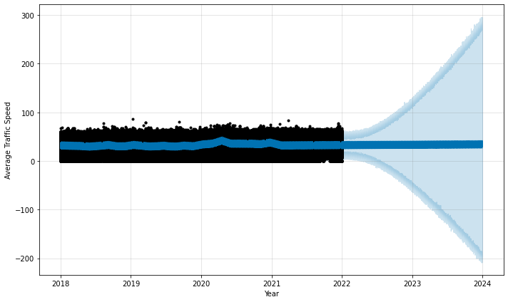
Time-Series Projections
Notes:
These are the projections obtained for the average traffic of entire NYC City.
Future work would working on training model for individual / group of Link Points to extract valuable information.
We have the code ready to train individual models, however we are limited by the computational resources, that we have.
We will continue to look into ways to simplify the training process.

Slide 26
Decision Tree (NYC: DoT Traffic Speed Dataset)

Slide 27
Decision Tree
We have split the dataset in 80:20 with random state as 42
The accuracy for the model is 77% before the pruning
Notes:
We attempted to make a decision tree and this is why (reasoning)
This is the result of that attempt (show unpruned tree)
But we ran into issues with making the tree and these are what those issues were
What we thought the data should have told us/looked like
Accuracy wasn’t high enough
Results weren’t worth it relative to what we had

Slide 28
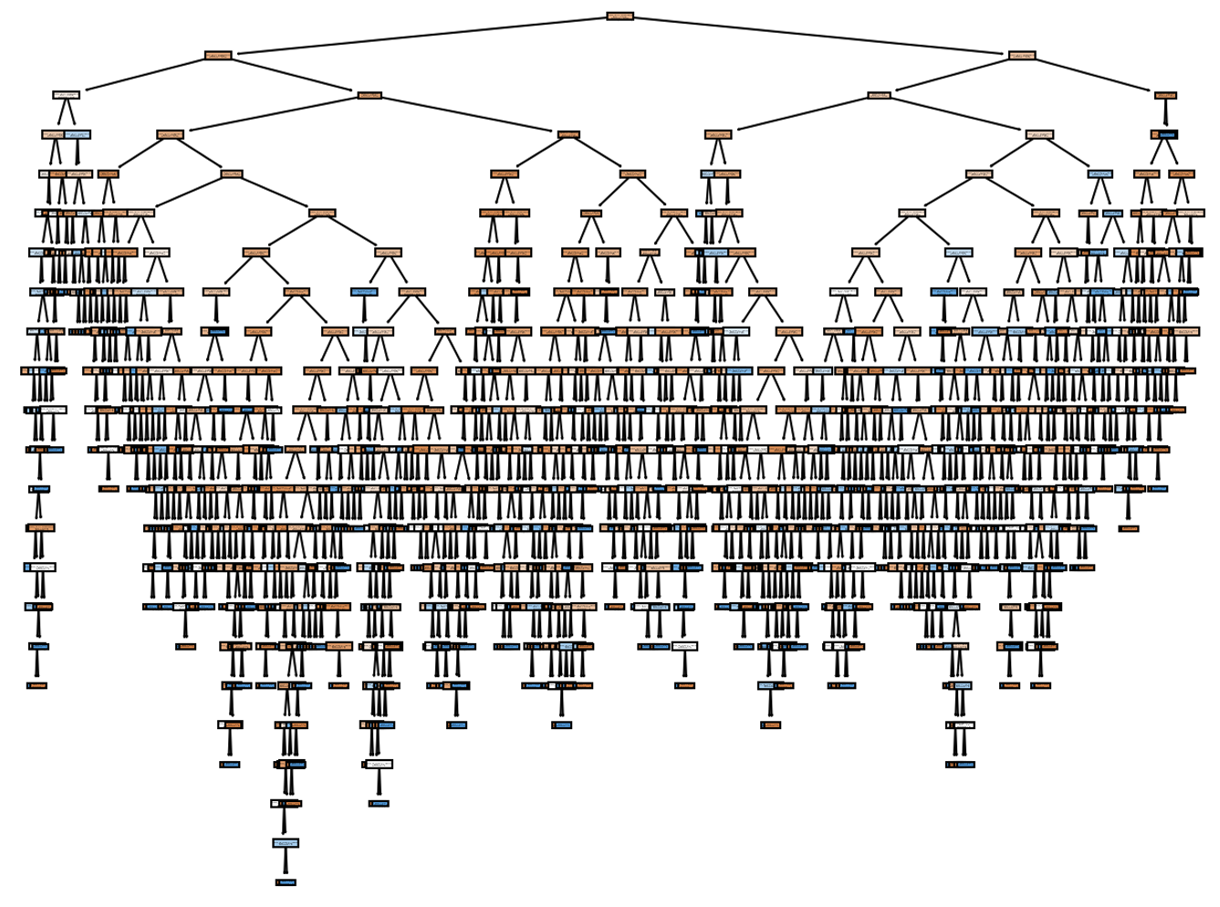
Decision tree

Slide 29
MARS Analysis (NYC: DoT Traffic Speed Dataset)

Slide 30
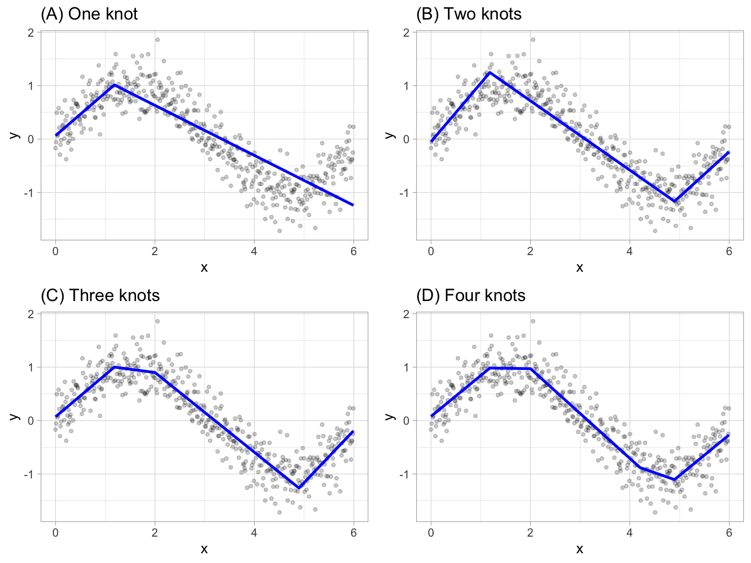
What is MARS? (HINT: not the planet)
MARS stands for
Multi-variate
Multiple variables/factors
Adaptive
Based on hinge functions
Regression
Spline
Higher-order polynomials
Source: https://bradleyboehmke.github.io/HOML/06b-mars_files/figure-html/examples-of-multiple-knots-1.png
Notes:
We attempted this
What the issues were
What we thought the data should have told us
Linear aggression is not enough, too simple
MARS was not viable, too complex/computationally expensive
Tried to do it (MARS) on a sample, took too much time, time series analysis gave better results

Slide 31
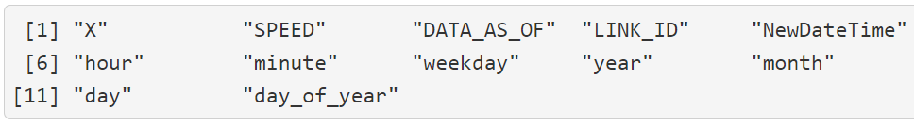
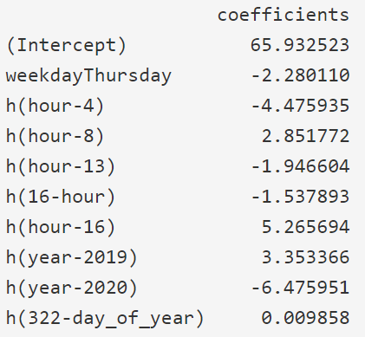
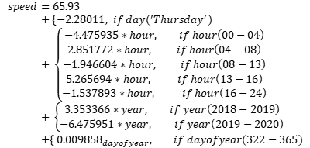
MARS Model Parameters

Slide 32
Drawbacks to MARS Analysis
Performed on sample data (100,000 records only)
Takes a lot of time to train, cross-validate and prune
Only used linear functions, fitting splines increases the processing time by a huge order
No proper working libraries for visualization. Hard-coding can take a lot of work-hours
Time-Series provides much better fit, in comparatively much lesser time.
Notes:
Linear aggression is not enough, too simple
MARS was not viable, too complex/computationally expensive
Tried to do it (MARS) on a sample, took too much time, time series analysis gave better results

Slide 33
Conclusions

Slide 34
Conclusions
Clustering analysis provided insight into high congestion/low speed areas
14 link points had a lower than average speed
Higher vehicle usage and low traffic flow due to bridges/toll
Being near/in the Manhattan borough
During the year 2020, the average speed was faster
Likely due to COVID leading to less travel in general
Notes:
Overall results/data
14 link points had a speed lower than the average
Could be the result of:
Higher number of vehicles
Higher congestion due to being near bridges
Being near/in the Manhattan borough
During the year 2020, the average speed was faster
Likely due to COVID leading to less travel in general

Slide 35
Lessons Learned
How to work collaboratively with Databricks
Coordinating and dividing responsibilities
Based on skill set, time, etc
Managing a schedule and working towards realistic goals
Knowing what analysis will be useful to our goals
Identifying traffic patterns with a few attributes
Using complementary sources to find their causes
Notes:
Difficulties, how we learned to work with the technology

Slide 36
Future Considerations/Work
Multiple datasets combined could present a better picture to traffic conditions like speed or travel time.
Geospatial analysis for nearby congestion to recommend a path with a start and destination in mind
Additional consideration of features
Using an average lag or lead for k-means
# of lanes
Foot (pedestrian) traffic
Flow of traffic
One way or Bidirectional
Cardinal Direction
Notes:
Traffic has multiple variables that contribute to the flow of traffic and landscape factors like bridges and tolls. These are physical components that are measurable and predictable. But there are unforeseen circumstances like accidents and road maintenance that this study did not consider due to time constraints and lack of experience. Combine traffic conditions to accidents and road maintenance may help gain a better insight into the NYC traffic issue.
Performing geospatial analysis of the nearby area can influence the flow of traffic at the start or along the route. Consider an analogy of a pipe where water can flow through a pipe quickly if flow is not impeded.
Using geospatial data as additional features into a recommendation model with a starting point and a destination
Some consideration could be used as additional features like number of lanes, if road has foot traffic, if a road is a one way or bidirectional, and cardinal direction.

Slide 37
Works Cited
City of New York Department of Transportation NBE Dataset. Retrieved on March 9, 2022 from: https://data.cityofnewyork.us/Transportation/DOT-Traffic-Speeds-NBE/i4gi-tjb9
https://bradleyboehmke.github.io/HOML/mars.html
Real-time freeway traffic state prediction: A particle filter approach. 2011 14th International IEEE Conference on Intelligent Transportation Systems (ITSC)
Traffic Flow Prediction With Big Data: A Deep Learning Approach. IEEE Transactions on Intelligent Transportation Systems.
Using Big Data-machine learning models for diabetes prediction and flight delays analytics. Journal of Big Data.
Big data analytics: predicting traffic flow regimes from simulated connected vehicle messages using data analytics and machine learning. US Department of Transportation.

Slide 38
Thank You !!!

